Slide 1
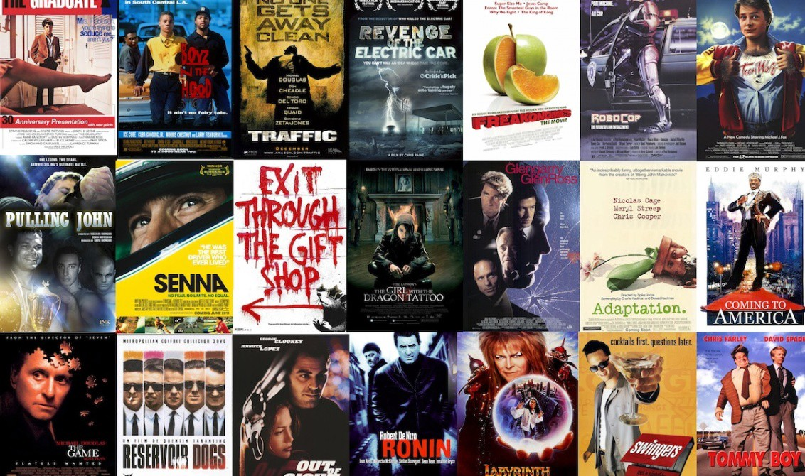
Movie Recommendation System
Mentee
Kushagra Sharma
Mentor
Athreyee Pandravada

Slide 2
Motivation
Over the past 5 years, watching movies and tv series on digital platforms is now a part of our lives.
Since there are a lot of options to watch from all of these streaming platforms, people might get lost and don’t know what to watch sometimes.
Those streaming platforms use prediction algorithms to recommend their users new media based on what they watch.
I aim to provide an effective solution to people who are looking for a movie that they can enjoy by using different machine learning algorithms together.

Slide 3

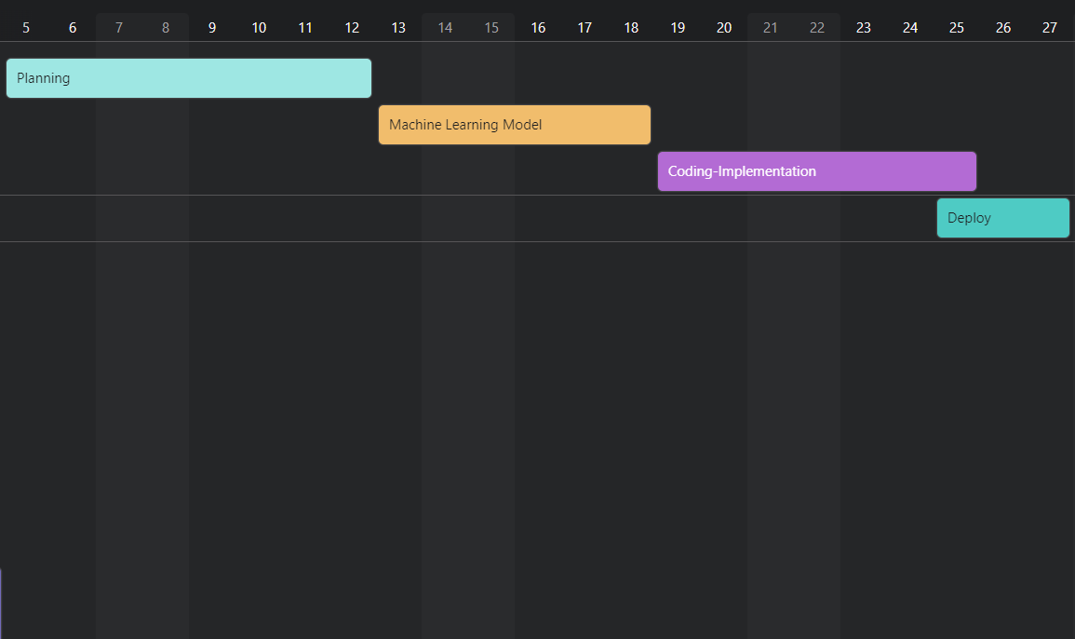
Sprint

Slide 4
Objectives
Definition: Developing a web application for people to find new movies based on their preferences and also from similar people’s preferences.
Main Features:
Predicting movies that users might enjoy.
Rate and comment section for registered users about movies.
Display and search among the database of movies.

Slide 5
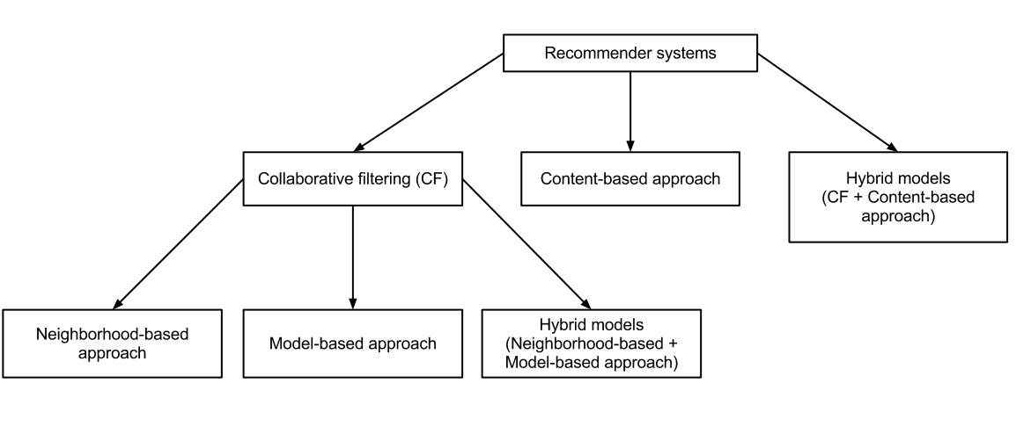
Collabarative Filtering
Collaborative filtering is a method of making automatic predictions (filtering) about the interests of a user by collecting preferences or taste information from many users (collaborating).In our project, we will use two main approaches. These are;
Item Based Recommendation
User Based Recommendation

Slide 6
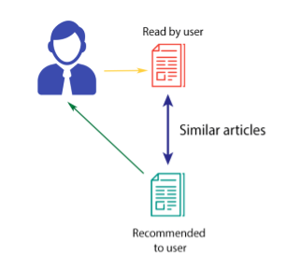
What Is Item-Based Recommendation?
Item-based is a form of collaborative filtering for recommender systems based on the similarity between items calculated using people's ratings of those items.
Methods For Finding Similarity:
Cosine Based Similarity
Adjusted Cosine Similarity

Slide 7
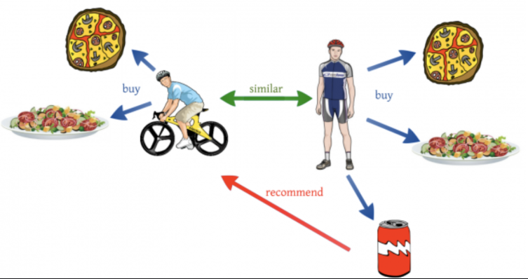
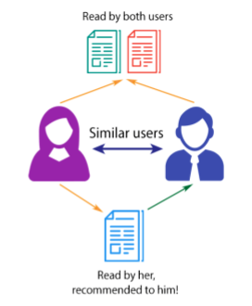
What Is User-Based Recommendation?
User-based is also a form of collaborative filtering for recommender systems that recommends items by finding similar users to the active user (to whom we are trying to recommend a movie for example).

Slide 8
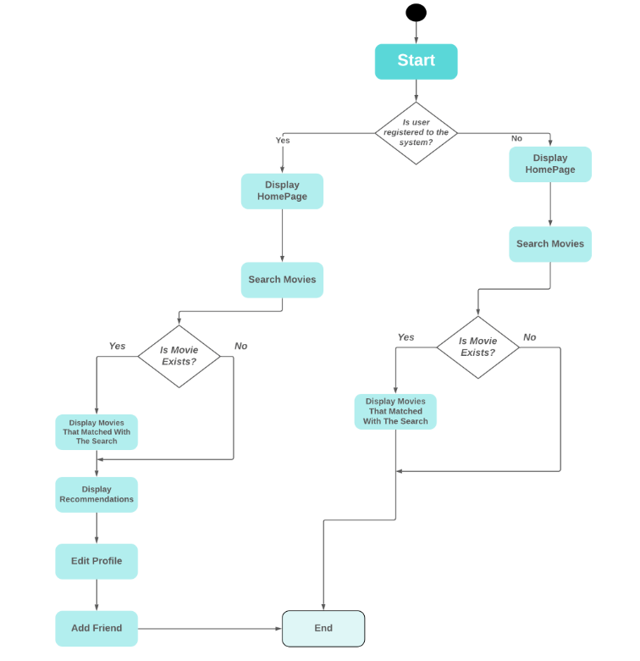
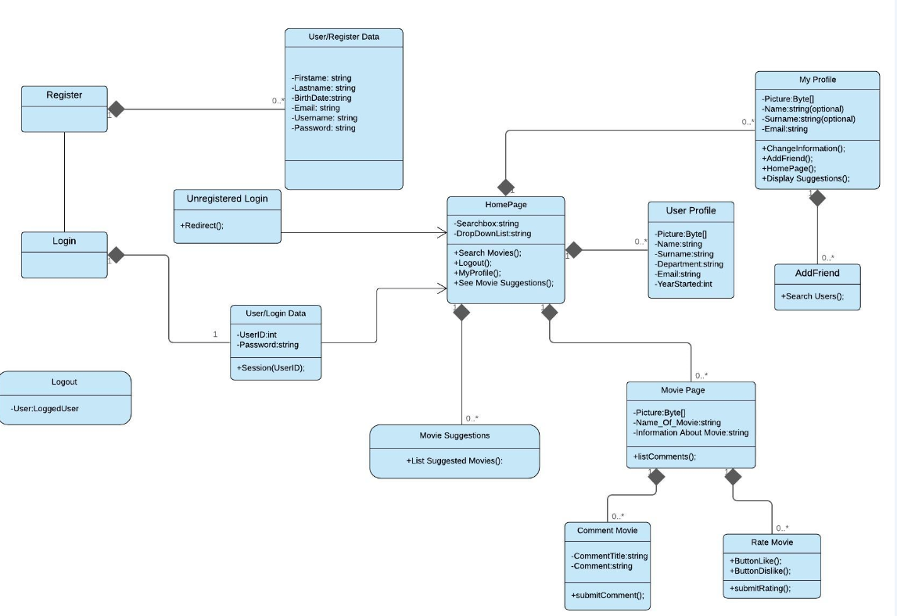
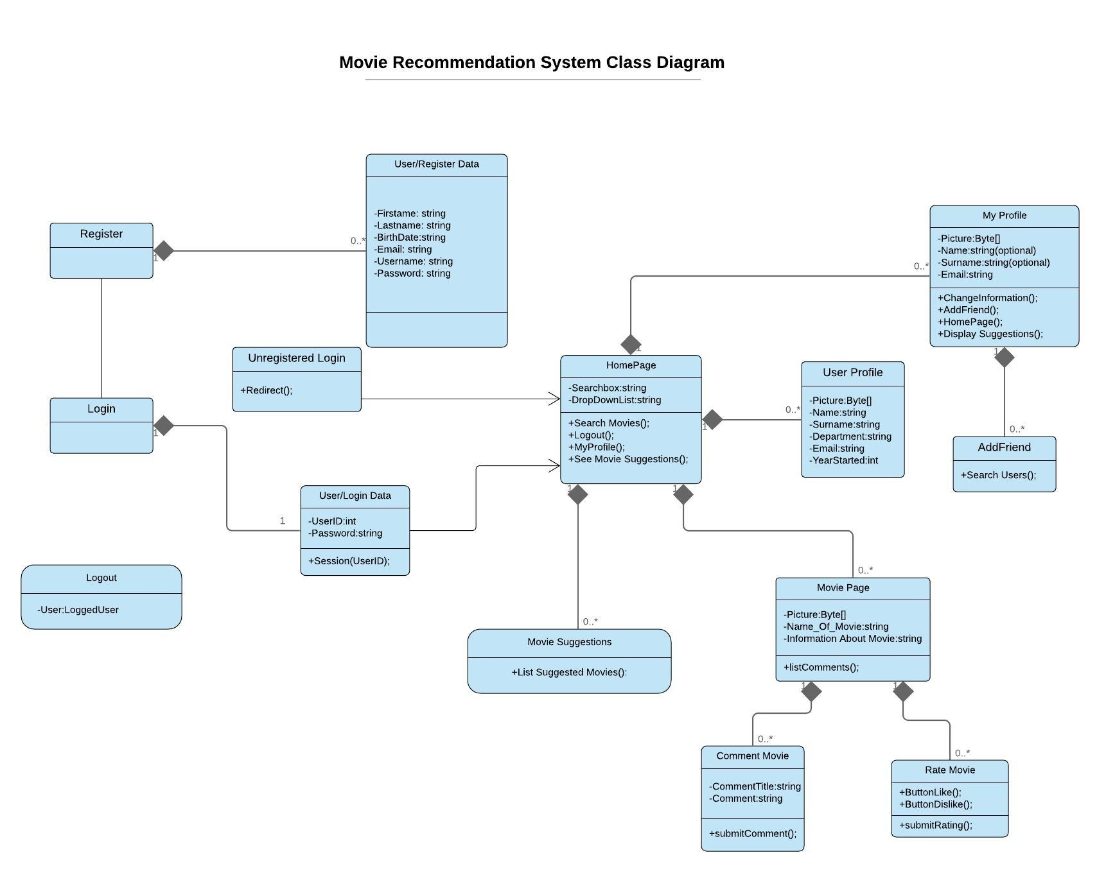
Materials And Methods
Activity Diagram
Class Diagram

Slide 9
Success Criteria
Success Criterion | How To Measure
Accuracy Of Movie Recommendations | By manually checking the contents of the recommended movies.
Apply Efficient Prediction Algorithms | Testing the algorithms, user feedback
Simple And Responsive Interface | By checking user feedback.
Provide Reliable Data | Analyzing and testing the data.

Slide 10




Technology Used
Python
Django
Vue.js
PostgreSQL

Slide 11
Results And Conclusion
In conclusion, using both collabarative filtering approaches, we will try to provide a good experience for the users that search for a movie based on their preferences.
It will bring together users with similar movie tastes in the system.

Slide 12
Thank You!

